Slide 1
Informal Visitor Contacts

Slide 2

The NPS Mission – preserve and protect unimpaired for the enjoyment of this and future generations.
Why are we here?
Notes:
What is TPERP – Why are we here today?

Slide 3
Why and how do we improve or enhance the visitor’s experience?

Slide 4
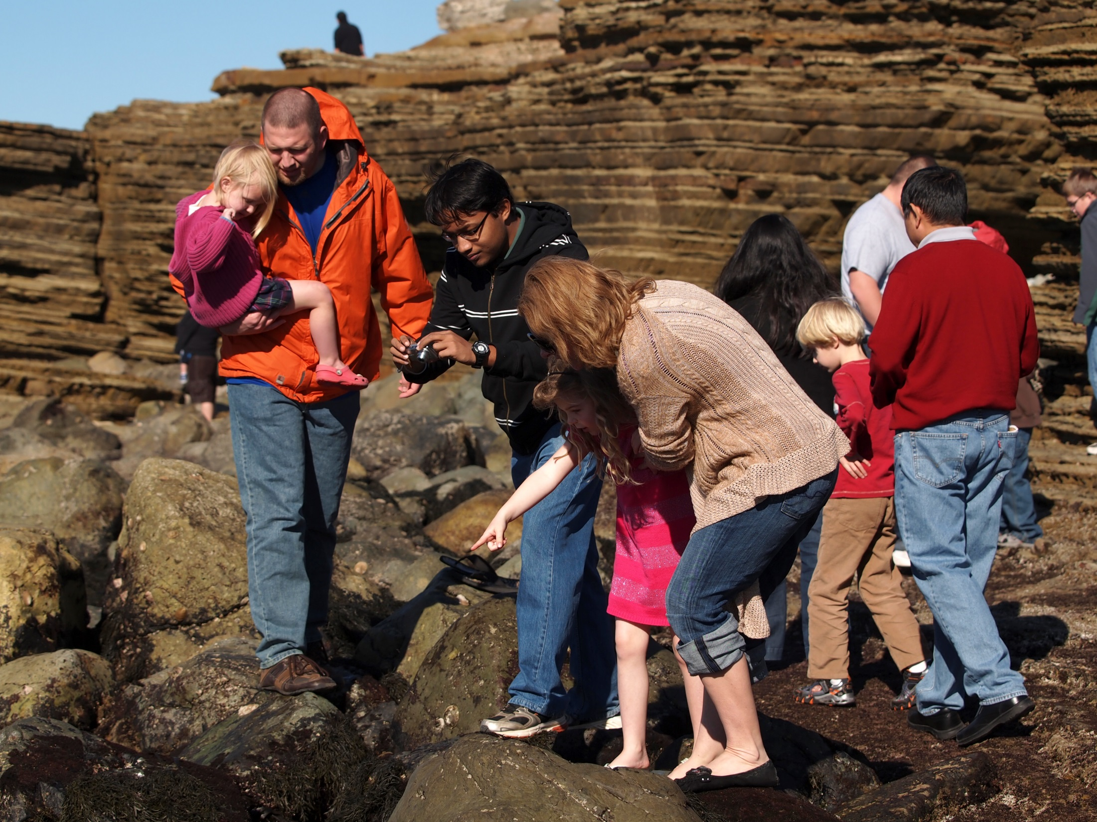

Slide 5

When we love something, we will take care of it.
The why…
In order to love it, we need to understand it.

Slide 6
The how…
What is interpretation?
A quick but giant collective brainstorm…

Slide 7
There isn’t one single correct answer when defining interpretation, but the NPS says this:
“Interpretation is a catalyst in creating opportunities for the audience to form their own intellectual and emotional connections with the meanings and significance inherent in the resource.”
Interpreters are “Visitor Experience Specialists”

Slide 8
And then there’s the equation:
(KA + KR) AT = IO

Slide 9
What is this class?? Algebra???
Oh….. %^&**&!

Slide 10
(KR + KA) AT = IO
Knowledge of the Resource (KR)
Knowledge of the Audience (KA)
Apply the Appropriate interpretive Technique (AT)
Can lead to an Interpretive Opportunity (IO)
Notes:
Explain slide – ask Question – “how do we learn about the resource?”
Explain slide – how do we learn about the audience?

Slide 11
www.eppley.org
Take this free class:
Foundations of Interpretation
- how to create intellectual and emotional connections between the visitor and the resource
Notes:
Go here for the basics – new folks and returning. The focus of this talk tonight is more about our interaction with the visitor in an informal setting. How do we meet the visitor’s need.

Slide 12
(KA) – Meeting the needs of the visitor
Direct communication – they ask something
Body language
Tone of Voice
Notes:
How do we know what the visitor needs….
Are they asking a direct question? Listen.
What is their body language – are they walking away? Leaning toward you?
What is their tone of voice? - are they excited, or disinterested, or perhaps angry?

Slide 13
Direct communication
  “What time is the 1:00 movie?”
  What are they really asking you?
  BTW – Don’t laugh ☺
Notes:
Visitors don't always know how to phrase the question they really want answered. They are overwhelmed by their surroundings and their senses may be overstimulated. They are also probably on vacation and may be extra relaxed. Never laugh at a visitor question – unless they are truly joking with you. Don’t assume. This question may be asking if the film is truly starting on time? Or… What is the best time to get a seat in the auditorium, in case it is crowded? Or – just a confirmation that this particular film is showing in the auditorium at 1pm.

Slide 14
Cues of an interested visitor:
leaning body toward you
arms are open, behind or to the side
remains still and pays attention
relaxed lips

Slide 15
Cues that a visitor is not interested:
stepping back, turning away
crossed arms
tapping or fidgeting
avoiding eye contact
lips pressed together

Slide 16
The interpretive continuum:
There are three types of informal visitor contacts…
Orientation (where questions)
Information (what, when and how questions)
Interpretation (why, or follow up questions)
Notes:
Orientation – where’s the bathroom? How do I get to the lighthouse?
Information – What is that object in the display case?
Interpretation – Why don’t we see an gray foxes? Why don’t we see sea stars like we did in the 70’s?... Or any follow up question to an informational question.

Slide 17
Things to remember: Basic or in depth?
A specific question deserves a specific answer
Do you have sufficient knowledge to provide a detailed response?
Study the visitor’s body language
A visitor who smiles, leans forward and makes eye contact is often interested

Slide 18
Types of Interpretive Techniques:
Analogy
Cause and Effect
Compare and Contrast
Description
Discussion and Dialogue
Examples
Explanation
Gestures
Illustration
Metaphor
Illustration
Photograph
Presentation of Evidence
Prop
Questioning
Storytelling
And… the list goes on

Slide 19
Appropriate Techniques:
**Must be appropriate for the resource, the audience and the interpreter
Notes:
You may not do the same type of technique with a child as you would for an interpretive program for adults. Think about your audience.

Slide 20
Learn about Tangibles, Intangibles and Universal Concepts
(Focus of the Foundations Course)
Notes:
Take the Foundations Eppley course to learn about Tangibles, Intangibles and Universal Concepts – which is a key way to help visitors make intellectual and emotional connections with the resources.

Slide 21
www.eppley.org
Foundations of Interpretation – Free
NPS History – Free
Informal Visitor Contacts
Interpretive Talk
Interpretive Writing
Conducted Activities
Demonstration
Other Resources: idp.eppley.org (NPS curriculum/training)
National Association for Interpretation (NAI) www.interpnet.com
Talk to Bonnie – Registered Learning Coach – Eppley (Advanced)
Notes:
Yes – take these classes and check out these websites.

Slide 22
"Through interpretation, understanding; through understanding, appreciation; through appreciation, protection."
Freeman Tilden

